Slide 1


Slide 2

Intermediate Python for Data Science
Welcome!
David Asboth
Instructor, Pluralsight
Notes:
Mandatory
ACTION: Adjust title to fit your course.

Slide 3
Day 1
Exploratory Data Analysis with pandas
Reading data
Manipulating data
Joining data
Descriptive statistics
Day 2
Data visualization with pandas
APIs
Web scraping
Day 3
pandas best practices
Object-oriented programming in Python
Notes:
Mandatory
ACTION: Adjust agenda as per your course.
The agenda provides students a roadmap of where the class is going and what is coming up. Keep it high level, as there is no need to include “Gazornin” in the agenda if that’s something they don’t understand. Refer to the agenda at the beginning of the class, at the end of every day and at the beginning of every morning. In the mornings, the Agenda is a great way to facilitate a Q&A session about what was covered on the previous day.

Slide 4
How we’re going to work together
You’ll have a copy of all the course materials shortly
We’ll be using Jupyter notebooks
You’ll be following along in the notebook and..
doing coding exercises/labs inside the notebook as well
Exercises will be in small breakout rooms
Notes:
Mandatory
ACTION: Adjust bullets as per your course.
In this section, discuss the structure of the course—exercises, labs, etc.
Also, discuss any resources students will be using.

Slide 5
Getting Python working
You should already have Miniforge installed. If you don’t, please do so now:
https://github.com/conda-forge/miniforge

Slide 6
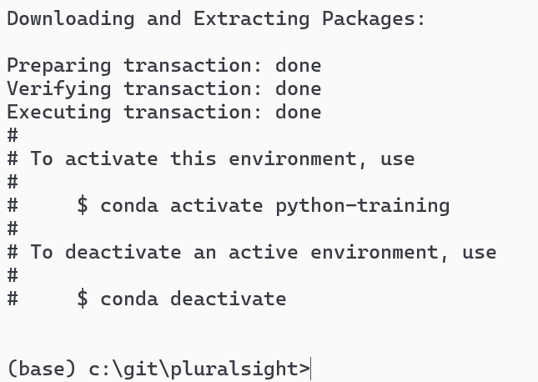
Setting up the environment
We need some more Python libraries. We can install them into a virtual environment. You can have multiple virtual environments, each with different libraries installed.
1. Create the environment:
conda create –n python-training python=3.12

Slide 7
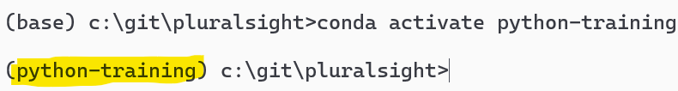
Setting up the environment (continued)
2. Activate the environment:
conda activate python-training

Slide 8
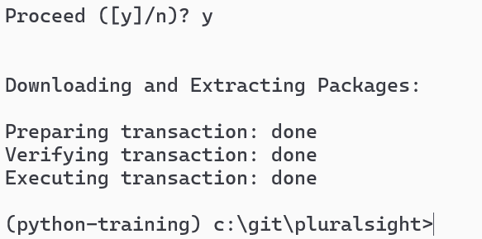
Setting up the environment (continued)
3. Install the necessary libraries:
conda install pandas numpy jupyter matplotlib seaborn requests bs4

Slide 9
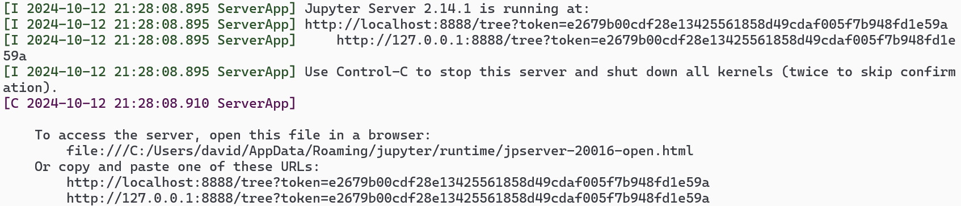
Setting up the environment (continued)
4. Launch Jupyter notebook:
jupyter notebook

Slide 10
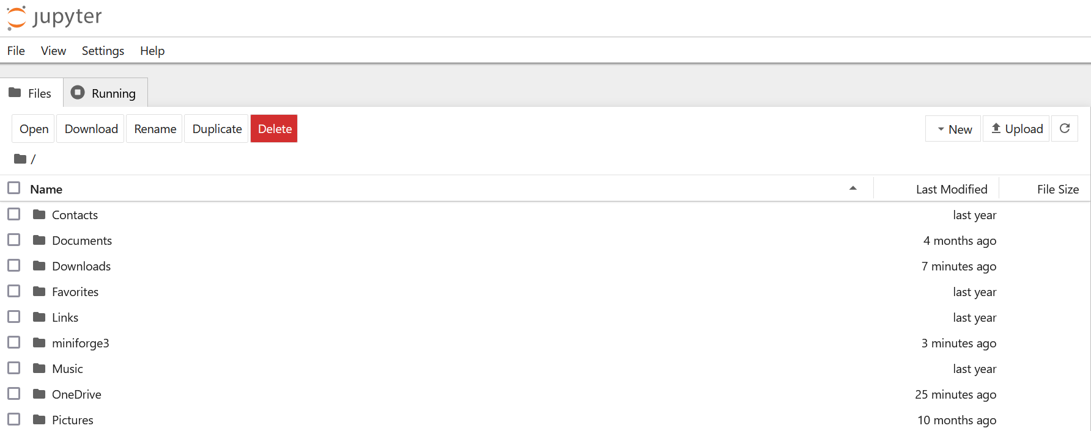
Getting Python working This is our end goal after the command: jupyter notebook

Slide 11
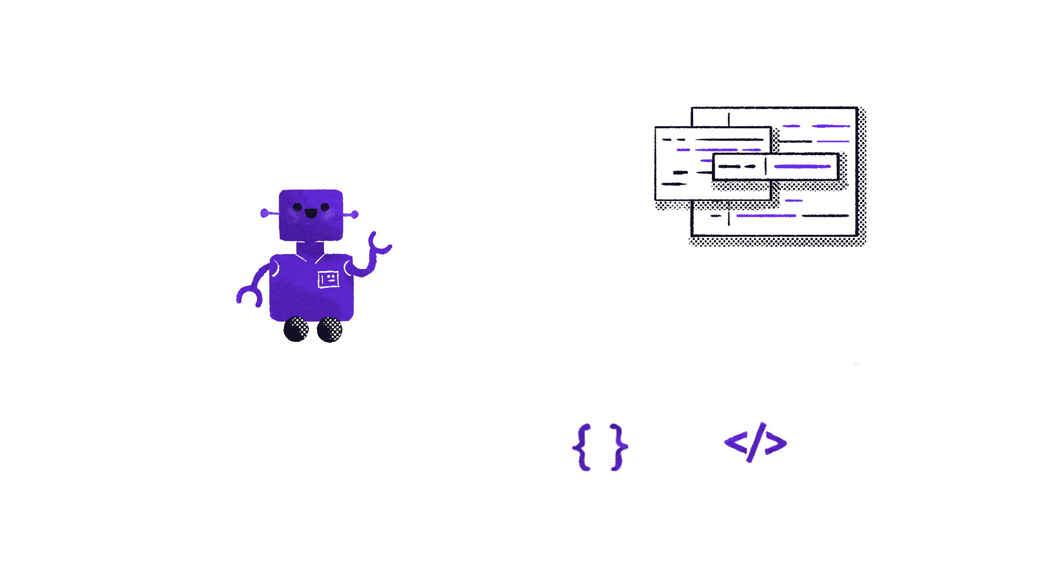
Let’s jump into today’s notebook!

Slide 12
Introducting pandas
Intro to Python

Slide 13
What is pandas?
pandas is the most popular data manipulation library in the Python ecosystem.
It lets us read, merge, manipulate, clean, and visualise data.
It also does this faster than using raw Python!
Read more: https://pandas.pydata.org

Slide 14
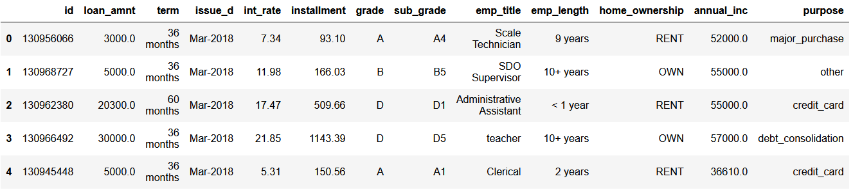
Series and DataFrames
pandas introduces two new types:
Series (single row or column)
DataFrame (2-D dataset)
Series
DataFrame
Series

Slide 15
Introduction to pandas

Slide 16
Help with pandas
The official documentation: https://pandas.pydata.org
Pandas cheat sheet: https://pandas.pydata.org/Pandas_Cheat_Sheet.pdf
Python for Data Analysis book (free online) by the creator of pandas: https://wesmckinney.com/book
pandastutor, a tool to visualise what different operations do: https://pandastutor.com
Notes:
Pros/cons of tuples vs. lists?

Slide 17
Data visualisation with pandas
Intro to Python

Slide 18
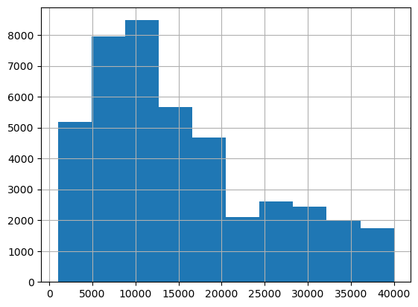
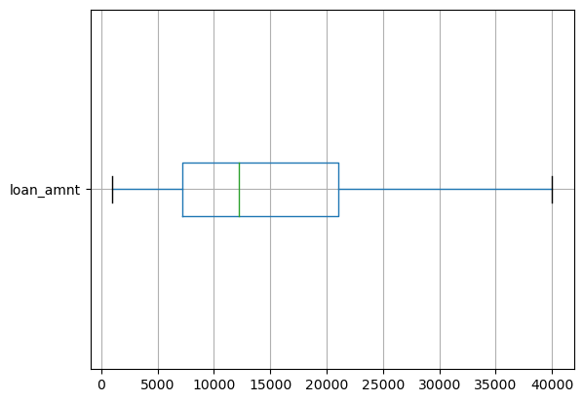
Distributions
To view the distribution of a column, we can use histograms or box plots
Notes:
Pros/cons of tuples vs. lists?

Slide 19
Data visualisation with pandas – distributions

Slide 20
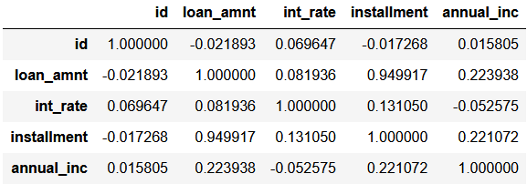
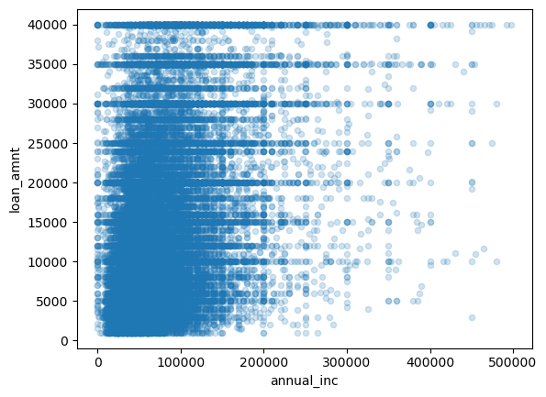
Scatter plots
Finding relationships between variables can be done:
Numerically (correlation)
Visually (scatter plots)
Notes:
Pros/cons of tuples vs. lists?

Slide 21
Data visualisation with pandas – relationships

Slide 22
Other options for visualisation
Seaborn (https://seaborn.pydata.org)
Plotnine (if you are an R/ggplot user, https://plotnine.readthedocs.io)
Plotly (for interactive visualisations, https://plotly.com/python)
Altair (https://altair-viz.github.io)

Slide 23
APIs
Intro to Python

Slide 24
What is an API?
API stands for Application Programming Interface
It’s how computers can be automated to send information to each other
Here, we’ll talking about sending data over the internet using APIs

Slide 25


How does the internet work?
When you type bbc.co.uk into a browser…
Our browser sends an HTTP request to BBC’s servers
Requests can be GET (to ask for something)
We can also send data with POST or PUT requests
The server determines what to do with the request
Is the request valid?
Do you have permission to access what you requested?
The server sends back an HTTP response containing:
Metadata about the response (e.g. a status code)
The content you requested
A web page
Or…. data!

Slide 26
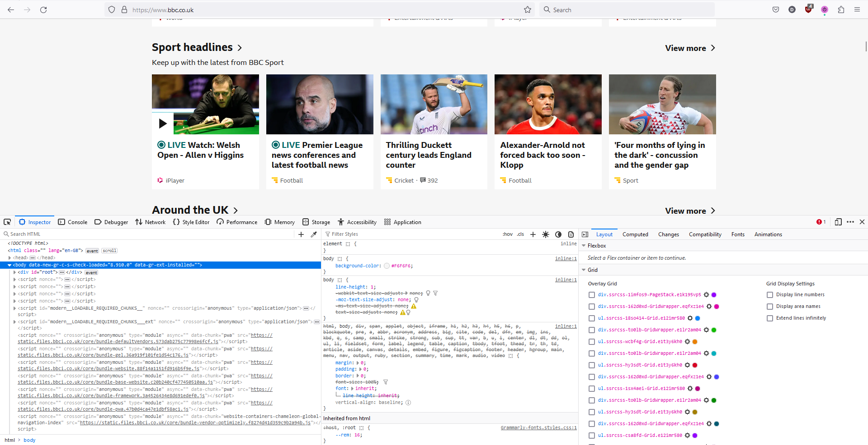
Developer Tools demo Press F12 or right-click and “inspect” something to open the Developer Tools

Slide 27
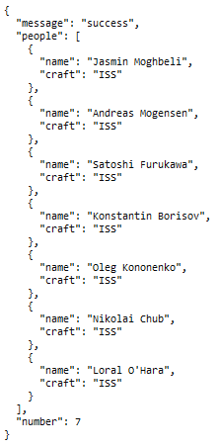
Viewing an API result
The API http://api.open-notify.org/astros.json tells you who’s currently in space
What kind of data does it return?

Slide 28
JSON
This is Javascript Object Notation (JSON)
It is text, but structured similarly to Python objects!

Slide 29
Changing a request
To get different data, we change the url.
https://earthquake.usgs.gov/fdsnws/event/1/query?format=geojson&starttime=2020-01-01&endtime=2020-01-02
? to separate url from parameters
Base API url
Parameter value
Parameter name
& to add more parameters

Slide 30
APIs with Python

Slide 31
Web scraping
Intro to Python

Slide 32
“Web scraping” means extracting data from a web page (not an API)

Slide 33
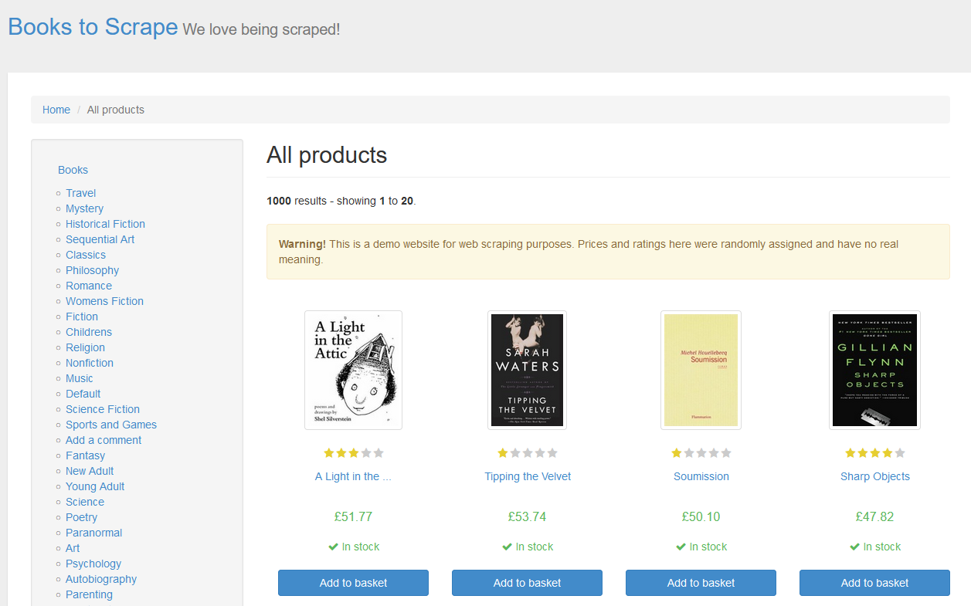
Web scraping
There’s data here!

Slide 34
Developer Tools demo Let’s use the Dev tools to find the underlying HTML on a web page

Slide 35
Web scraping in Python

Slide 36
Advanced pandas concepts

Slide 37
Object-oriented programming
Intro to Python

Slide 38
What do you think of when you hear “object-oriented programming”?

Slide 39
OOP in Python
Python is:
Dynamically typed
Interpreted, not compiled
Despite these properties, object-oriented programming is possible in Python.

Slide 40
OOP in Python

Slide 41
What next with Python?
pandastutor: https://pandastutor.com/
Python for data science? Try Python for Data Analysis
More pandas practice? Solve problems! I also highly recommend Effective Pandas 2
YouTube channels to follow:
Reuven Lerner
Arjan Codes

Slide 42
Reflection
3 things you’ve learned
3 things you want to learn next

Slide 43

Thank you!
If you have any additional questions, please ask!If
Notes:
Mandatory -- Need bookend -- first and last thing they should see is Pluralsight.
ACTION: Use this for the final slide of your class materials. Include contact information so participants can reach you if they have questions after the course.

